Slide 1
Creation of a Statistical Ensemble for Tropical Cyclone Intensity Prediction
AMS 30th Conf on Hurr and Trop Met, 4/19/2012
13A.1
Kate D. Musgrave¹, Brian D. McNoldy^{1,3}, and Mark DeMaria²
¹CIRA/CSU, Fort Collins, CO
² NOAA/NESDIS/StAR, Fort Collins, CO
³Current Affiliation: RSMAS, University of Miami, Miami, FL
Acknowledgements: Yi Jin, Naval Research Lab
Michael Fiorino, Jeffrey Whitaker, Philip Pegion, NOAA/ESRL
Vijay Tallapragada, Janna O’Connor, NOAA/NWS/NCEP/EMC
Kate.Musgrave@colostate.edu

Slide 2
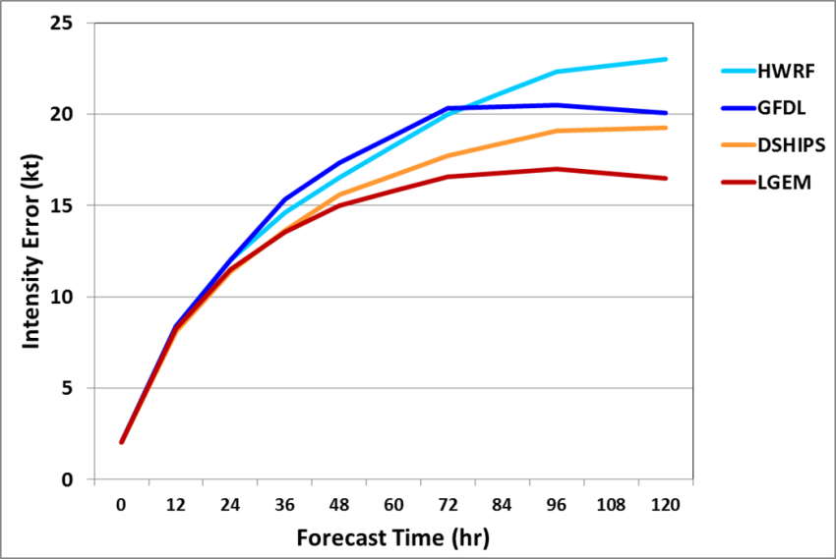
Motivation for Statistical Ensemble
AMS 30th Conf on Hurr and Trop Met, 4/19/2012
13A.1
The Logistic Growth Equation Model (LGEM) and the Statistical Hurricane Intensity Prediction Scheme (SHIPS) model are two statistical-dynamical intensity guidance models
SHIPS and LGEM are competitive with dynamical models
Both SHIPS and LGEM use model fields from the Global Forecast System (GFS) to determine the large-scale environment
Runs extremely fast (under 1 minute), using model fields from previous 6 hr run to produce ‘early’ guidance
Atlantic Operational Intensity
Model Errors 2007-2011
JTWC experience with a similar statistical model shows improvements with multiple inputs
We focus on using Decay-SHIPS (DSHP) and LGEM, initialized with model fields from GFS, the Hurricane Weather Research and Forecasting (HWRF) model, and the Geophysical Fluid Dynamics Laboratory (GFDL) model to create an ensemble

Slide 3
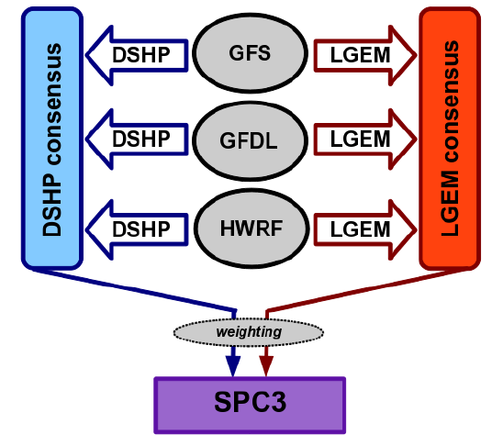
SPICE (Statistical Prediction of Intensity from a Consensus Ensemble)
AMS 30th Conf on Hurr and Trop Met, 4/19/2012
13A.1
SPICE forecasts TC intensity using a combination of parameters from:
Current TC intensity and trend
Current TC GOES IR
TC track and large-scale environment from GFS, GFDL, and HWRF models
These parameters are used to run DSHP and LGEM based off each dynamical model
The forecasts are combined into two unweighted consensus forecasts, one each for DSHP and LGEM
The two consensus are combined into the weighted SPC3 forecast
Model Configuration for Consensus

Slide 4
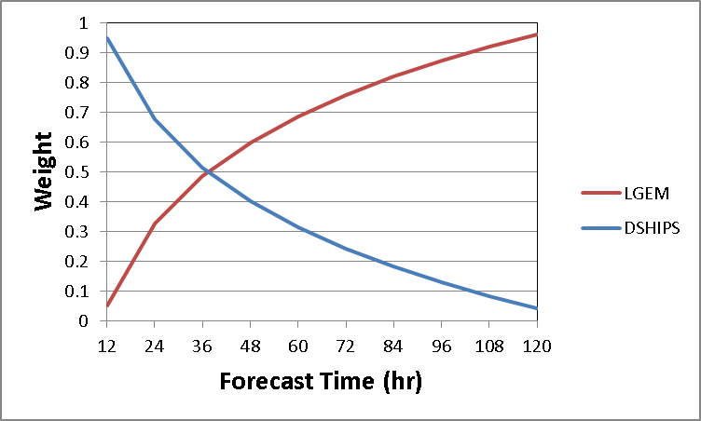
SPICE (Statistical Prediction of Intensity from a Consensus Ensemble)
AMS 30th Conf on Hurr and Trop Met, 4/19/2012
13A.1
Model Configuration for Consensus
DSHP and LGEM Weights for Consensus
Weights determined empirically from 2008-2010 Atlantic and East Pacific sample

Slide 5
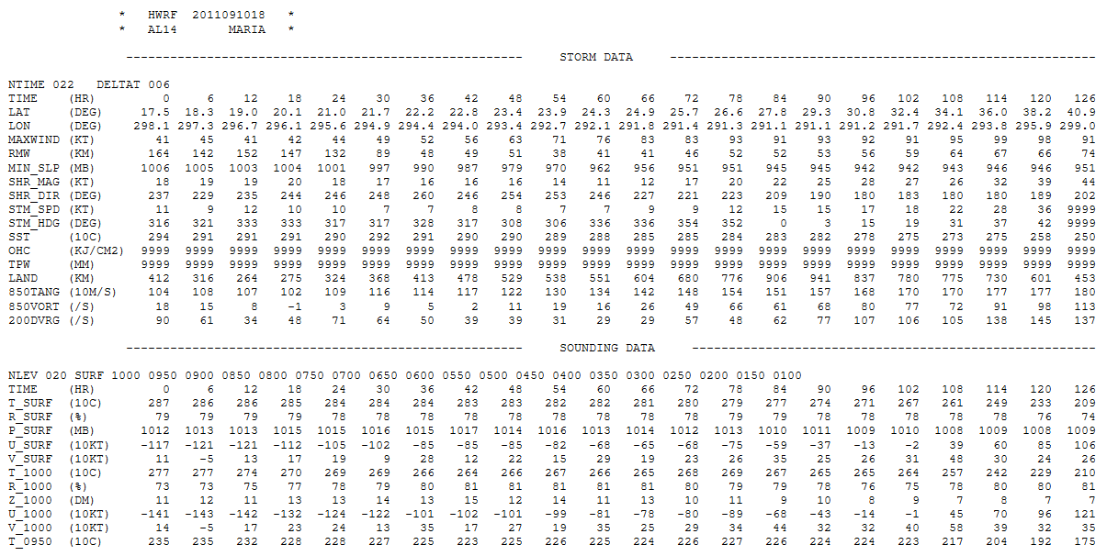
SPICE Input – Model Diagnostic Files
AMS 30th Conf on Hurr and Trop Met, 4/19/2012
13A.1
…
For further discussion of the model diagnostic files, see 15A.3 Friday 11:00am

Slide 6
SPICE Input – Model Diagnostic Files
AMS 30th Conf on Hurr and Trop Met, 4/19/2012
13A.1
…
For further discussion of the model diagnostic files, see 15A.3 Friday 11:00am

Slide 7
SPICE Input – Model Diagnostic Files
AMS 30th Conf on Hurr and Trop Met, 4/19/2012
13A.1
…
For further discussion of the model diagnostic files, see 15A.3 Friday 11:00am

Slide 8
SPICE Input – Model Diagnostic Files
AMS 30th Conf on Hurr and Trop Met, 4/19/2012
13A.1
…
For further discussion of the model diagnostic files, see 15A.3 Friday 11:00am

Slide 9
SPICE Input – Model Diagnostic Files
AMS 30th Conf on Hurr and Trop Met, 4/19/2012
13A.1
…
For further discussion of the model diagnostic files, see 15A.3 Friday 11:00am

Slide 10
Hurricane Forecast Improvement Program (HFIP)
AMS 30th Conf on Hurr and Trop Met, 4/19/2012
13A.1
HFIP designates three streams for the testing and implementation of models (Streams 1, 1.5, and 2)
Further information on HFIP is available at www.hfip.org
SPC3 was tested with data from the 2008-2010 Atlantic and East Pacific seasons (retrospective runs) to determine if it would be used as a Stream 1.5 model in 2011
As a Stream 1.5 model SPC3 would be run real time during the 2011 demonstration period (August-October 2011)
Data from the 2009-2011 Atlantic and East Pacific seasons were used to test SPC3 for Stream 1.5 in 2012

Slide 11
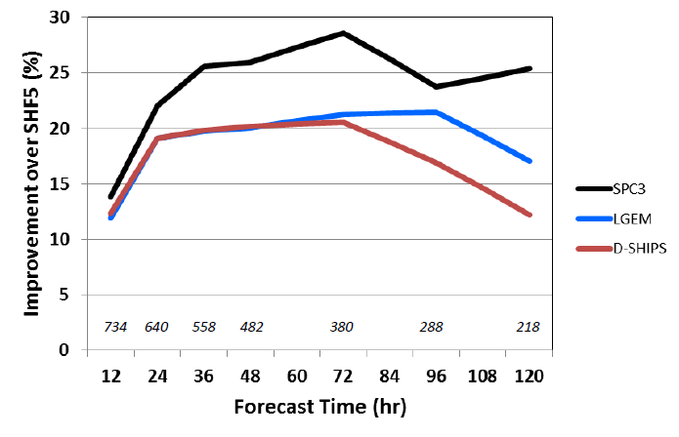
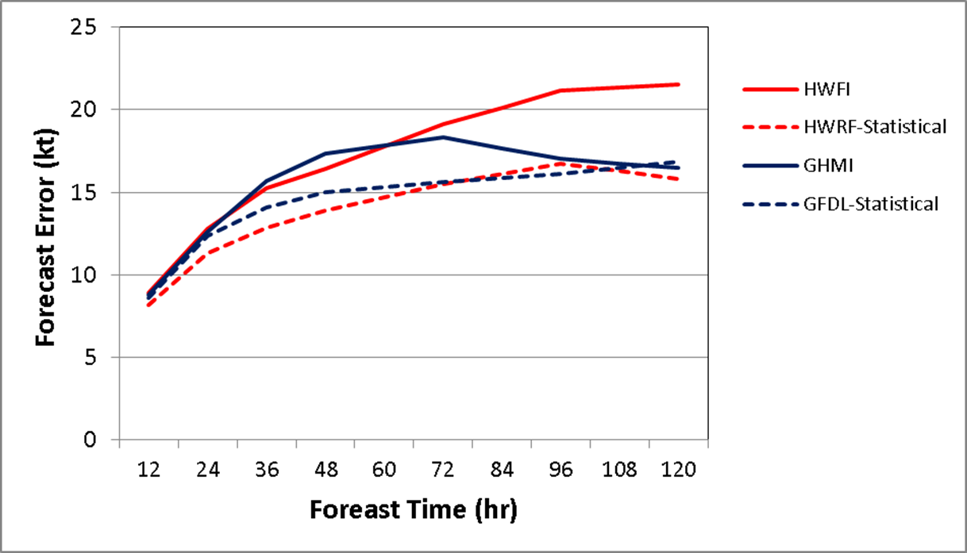
2008-2010 Retrospective Runs for HFIP Stream 1.5 Implementation
AMS 30th Conf on Hurr and Trop Met, 4/19/2012
13A.1
SPICE showed an improvement in skill over SHIFOR when compared to both DSHP and LGEM at all times
Percent improvements ranged up to 5-10%
The components of SPICE based off each individual model also showed lower forecast errors than their parent models for both HWRF and GFDL

Slide 12
Results from 2011 Atlantic Season
AMS 30th Conf on Hurr and Trop Met, 4/19/2012
13A.1
Average Intensity Error (kt)
Average Intensity Bias (kt)
(304) (301) (263) (225) (192) (150) (116) (92)
(304) (301) (263) (225) (192) (150) (116) (92)
Number
of Cases

Slide 13
Results from 2011 Atlantic Season
AMS 30th Conf on Hurr and Trop Met, 4/19/2012
13A.1
Skill Relative to SHIFOR
(304) (301) (263) (225) (192) (150) (116) (92)
Number
of Cases

Slide 14
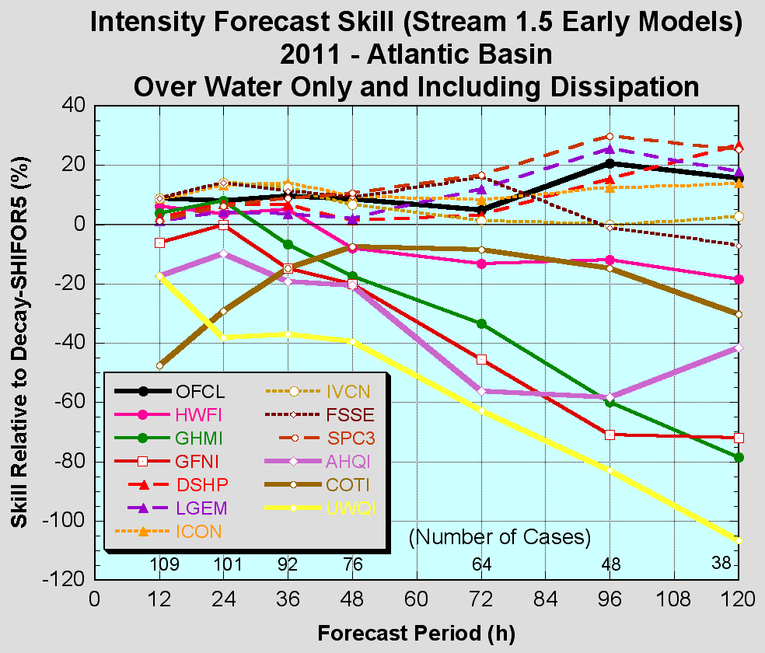
Results from 2011 Atlantic Season
AMS 30th Conf on Hurr and Trop Met, 4/19/2012
13A.1
Skill Relative to SHIFOR
(304) (301) (263) (225) (192) (150) (116) (92)
Number
of Cases
Figure courtesy of James Franklin

Slide 15
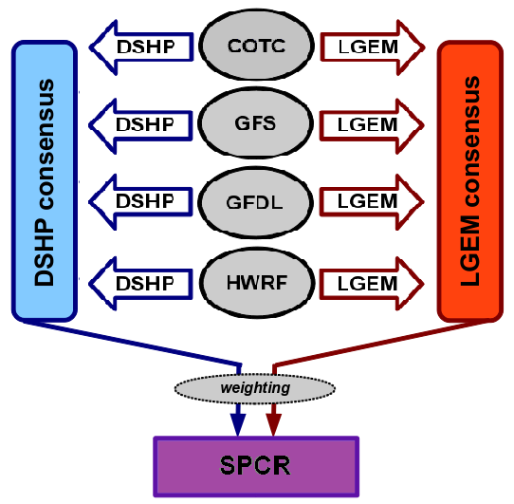
2012 HFIP Stream 1.5 Implementation
AMS 30th Conf on Hurr and Trop Met, 4/19/2012
13A.1
SPC3
SPCR
Additional Stream 1.5 model, named SPCR
Adds Coupled Ocean/Atmosphere Mesoscale Prediction System for Tropical Cyclones (COAMPS-TC, COTC) to regional models in ensemble

Slide 16
2009-2011 Retrospective Runs for HFIP Stream 1.5 Implementation
AMS 30th Conf on Hurr and Trop Met, 4/19/2012
13A.1
SPC3
SPCR
# cases
# cases
Time (hr)
Time (hr)
Average Intensity Error (solid) and bias (dashed) (kt)

Slide 17
Results from 2011 Atlantic Season
AMS 30th Conf on Hurr and Trop Met, 4/19/2012
13A.1
HWRF
GFDL
Average Intensity Error (kt)
Average Intensity Bias (kt)

Slide 18
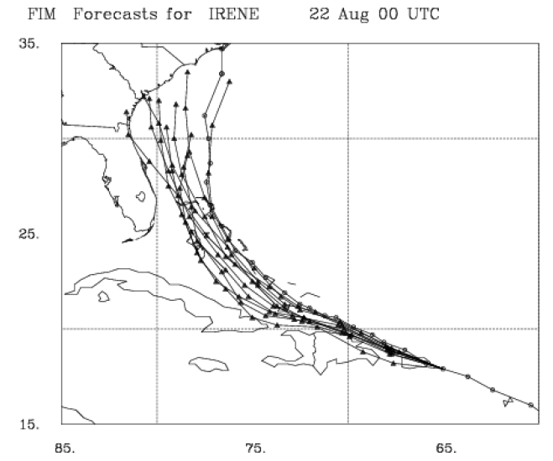
2012 HFIP Stream 2 Implementation – SPCG
AMS 30th Conf on Hurr and Trop Met, 4/19/2012
13A.1
FIM 10-member Ensemble
Stream 2 model, named SPCG
Uses GFS and global model ensembles as input models

Slide 19
Plans for 2012 Season
AMS 30th Conf on Hurr and Trop Met, 4/19/2012
13A.1
In 2012 we’ll run two separate versions of SPICE in HFIP Stream 1.5:
The first version (SPC3) is based off the 2011 SPICE model, with updated versions of SHIPS and LGEM
The second version (SPCR) includes COAMPS-TC
We’ll also collect model diagnostic files for regional models from SUNY-Albany and University of Wisconsin and test after the season for inclusion in SPCR
We’ll also run a version of SPICE in HFIP Stream 2:
The third version (SPCG) will include HFIP global model ensembles

Slide 20
Summary
AMS 30th Conf on Hurr and Trop Met, 4/19/2012
13A.1
Statistical ensemble (SPICE) is a weighted consensus of DSHP and LGEM, run from multiple dynamical models
SPICE had better error statistics than SHIPS and LGEM in the Atlantic basin, with neutral results in the Eastern Pacific basin
Consistent in 2008-2010 Retrospective Runs, 2011 Demonstration, and 2009-2011 Retrospective Runs
SPC3 showed skill improvements of up to 5-10% over SHIPS and LGEM
SPICE model components had lower errors than parent dynamical models (GFDL, HWRF)
Limited storm development in 2011 may have favored SPICE model
Confirmation from additional tests needed

Slide 21
Questions?
AMS 30th Conf on Hurr and Trop Met, 4/19/2012
13A.1

